Slide 1
COVID-19 Response in Boone County
Ashley Millham, MD
Medical Director, Columbia/Boone County Dept of Public Health and Human Services
Christian Rojas, MD
Interim Director, Division of Infectious Diseases; MU Healthcare and MU SOM

Slide 6
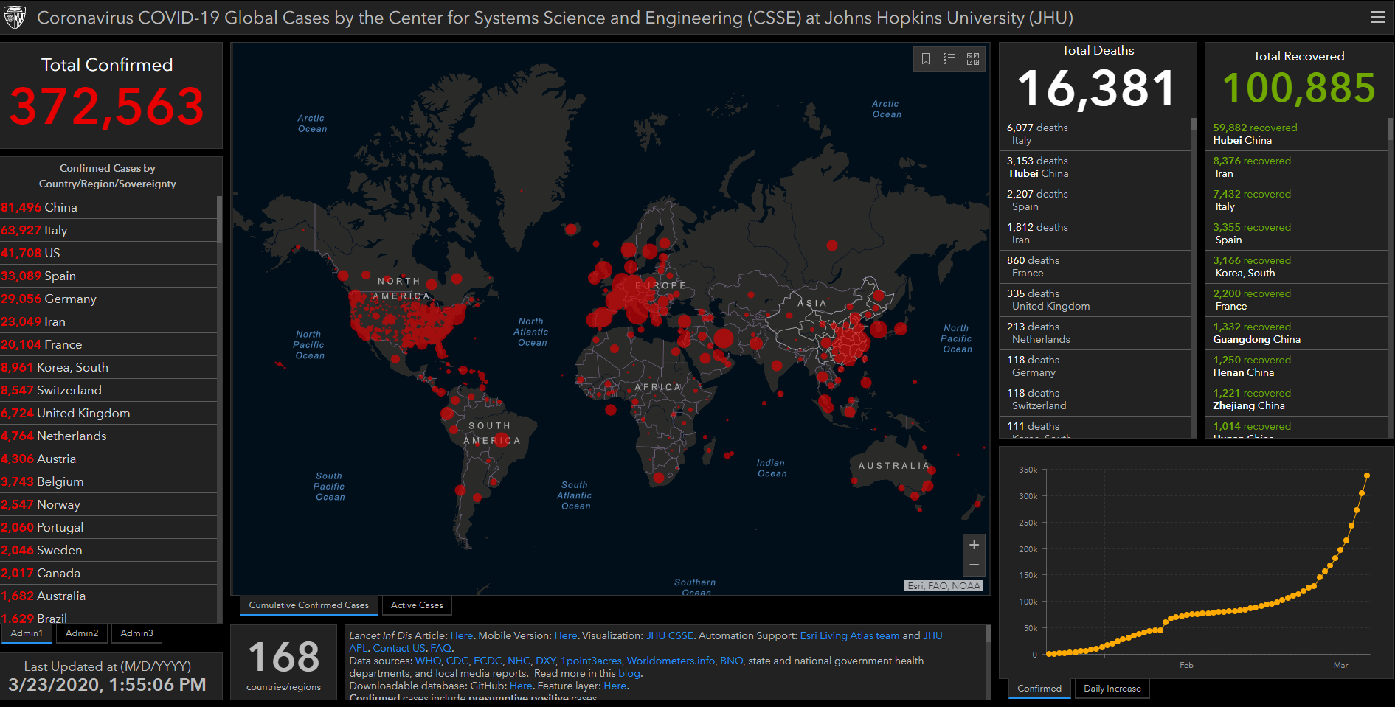

Slide 7
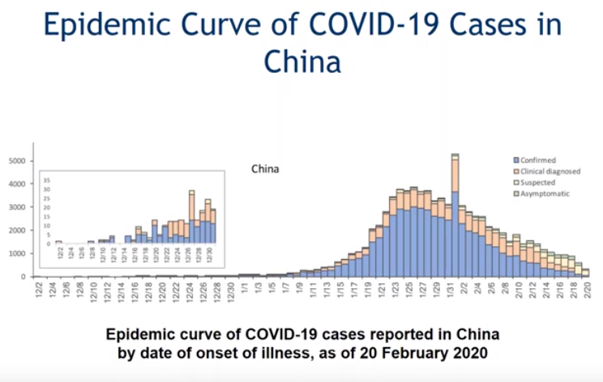
From Tue 3/10/20 webinar, Medical Society of Virginia:

Slide 8
From Tue 3/10/20 webinar, Medical Society of Virginia:

Slide 9
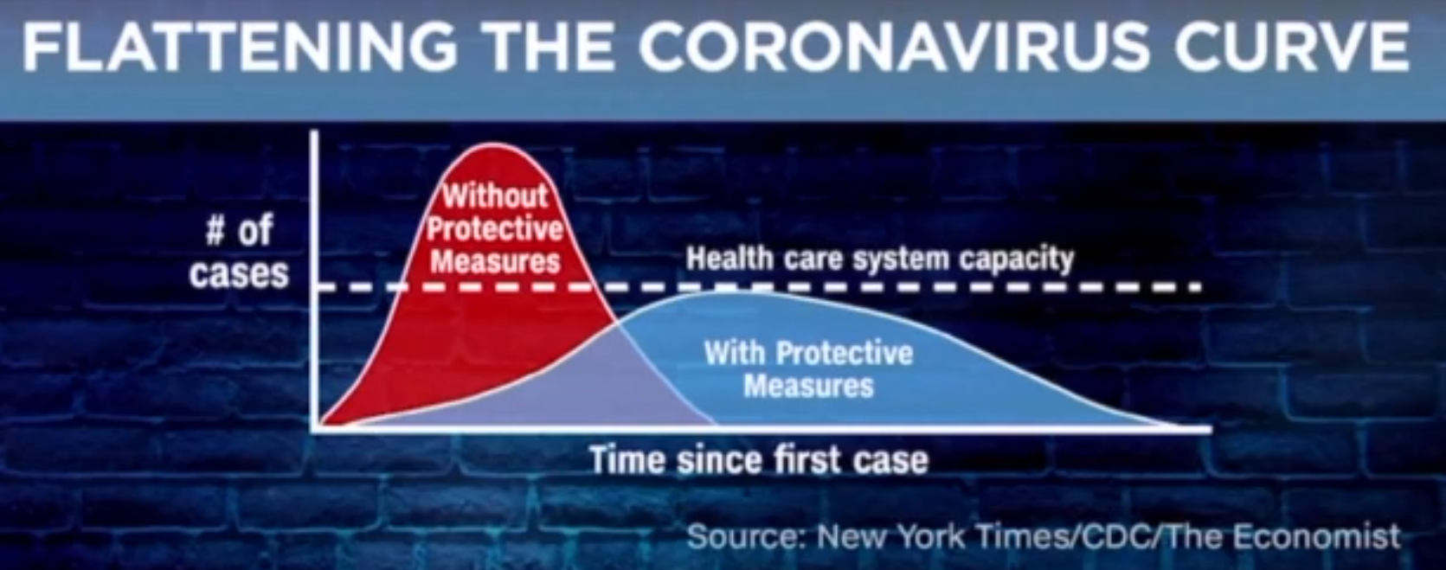

Slide 10
1918 Flu Pandemic: Effect of delaying preventative measures Philadelphia and St Louis
Notes:
St Louis managed to flatten their curve by implementing social distancing measures rapidly whereas Philadelphia decided to go ahead with a parade scheduled for Sept 28

Slide 11
COVID-19 Response in Boone County
SPEAKING: Ashley Millham, MD
Medical Director, Columbia/Boone County Dept of Public Health and Human Services
Christian Rojas, MD
Interim Director, Division of Infectious Diseases; MU Healthcare and MU SOM

Slide 12
COVID-19 Response in Boone County
Ashley Millham, MD
Medical Director, Columbia/Boone County Dept of Public Health and Human Services
SPEAKING: Christian Rojas, MD
Interim Director, Division of Infectious Diseases; MU Healthcare and MU SOM

Slide 13
Next event, Sat 3/28/20 at 8 am:
MSMA Conference Call with Randall Williams, MD;
Director of Missouri Department of Health
For more information:
https://health.mo.gov/
https://www.msma.org/coronavirus-2019-covid-19.html
https://www.ama-assn.org/delivering-care/public-health/covid-19-2019-novel-coronavirus-resource-center-physicians

